Slide 1
Unit 2: Data Warehouse Logical Design
Lecturer : Bijay Mishra

Slide 2
Database Development Process
Enterprise modeling
Conceptual data modeling
Logical database design
Physical database design and definition
Database implementation
Database maintenance

Slide 3
A conceptual data model include identification of important entities and the relationships among them. At this level, the objective is to identify the relationships among the different entities.

Slide 4
What is a Logical Design??

Slide 5
Logical Design
Logical design is the phase of a database design concerned with identifying the relationships among the data elements.
A logical design is conceptual and abstract. You do not deal with the physical implementation details yet. You deal only with defining the types of information that you need.
Logical design deals with concepts related to a certain kind of DBMS (e.g. relational, object oriented,) but are understandable by end users

Slide 6
The logical design should result in
A set of entities and attributes corresponding to fact tables and dimension tables.
A model of operational data from your source into subject-oriented information in your target data warehouse schema.
You can create the logical design using a pen and paper, or you can use a design tool such as Oracle Warehouse Builder (specifically designed to support modeling the ETL process) or Oracle Designer (a general purpose modeling tool).

Slide 7
The steps of the logical data model include identification of all entities and relationships among them. All attributes for each entity are identified and then the primary key and foreign key is identified. Normally normalization occurs at this level.
In data warehousing, it is common to combine the conceptual data model and the logical data model to a single step. The steps for logical data model are indicated below:
Identify all entities.
Identify primary keys for all entities.
Find the relationships between different entities.
Find all attributes for each entity.
Resolve all entity relationships that is many-to-many relationships.
Normalization if required.

Slide 8
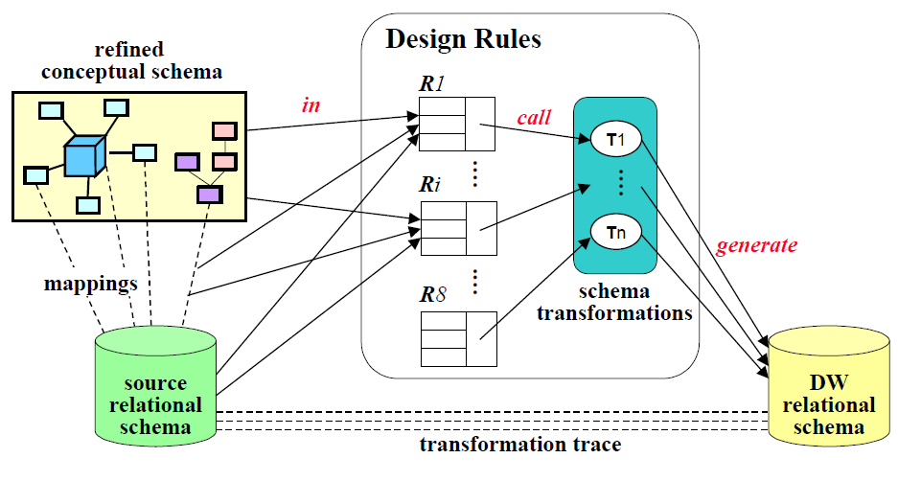
Figure: Data warehouse logical design environment.

Slide 9
The environment provides the infrastructure to carry out the specified process. It consists of:
A refined conceptual schema, which is built from a conceptual multidimensional schema enriched with design guidelines.
The source schema and the DW schema.
Schema mappings, which are used to represent correspondences between the conceptual schema and the source schema.
A set of design rules, which apply the schema transformations to the source schema in order to build the DW schema.
A set of pre-defined schema transformations that build new relations from existing ones, applying DW design techniques.
A transformation trace, which keeps the transformations that where applied, providing the mappings between source and DW schemas.

Slide 10
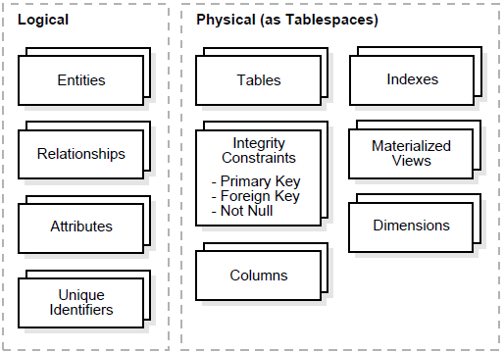
Logical Design compared with Physical Design

Slide 11
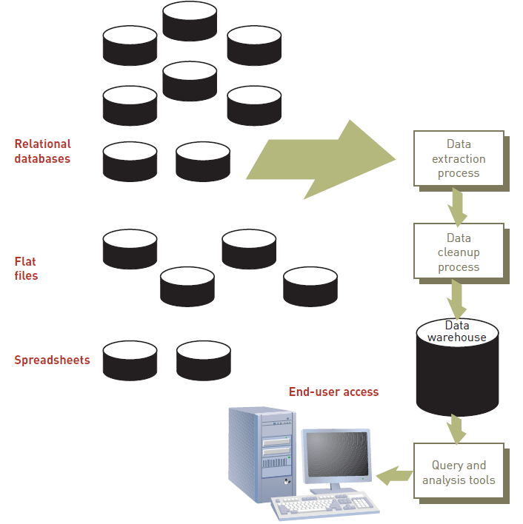
From Tables and Spreadsheets to Data Cubes

Slide 12
The process of logical design involves arranging data into a series of logical relationships called entities and attributes.
An entity represents a chunk of information. In relational databases, an entity often maps to a table.
An attribute is a component of an entity that helps define the uniqueness of the entity. In relational databases, an attribute maps to a column.

Slide 13
Relational database model’s structural and data independence enables us to view data logically rather than physically.
The logical view allows a simpler file concept of data storage.
The use of logically independent tables is easier to understand.
Logical simplicity yields simpler and more effective database design methodologies.

Slide 14
An entity is a person, place, event, or thing for which we intend to collect data.
University -- Students, Faculty Members, Courses
Airlines -- Pilots, Aircraft, Routes, Suppliers
Each entity has certain characteristics known as attributes.
Student -- Student Number, Name, GPA, Date of Enrollment, Data of Birth, Home Address, Phone Number, Major
Aircraft -- Aircraft Number, Date of Last Maintenance, Total Hours Flown, Hours Flown since Last Maintenance
A grouping of related entities becomes an entity set.
The STUDENT entity set contains all student entities.
The FACULTY entity set contains all faculty entities.
The AIRCRAFT entity set contains all aircraft entities

Slide 15
A table contains a group of related entities -- i.e. an entity set.
The terms entity set and table are often used interchangeably.
A table is also called a relation.
While entity-relationship diagramming has traditionally been associated with highly normalized models such as OLTP applications, the technique is still useful for data warehouse design in the form of dimensional modeling.

Slide 16
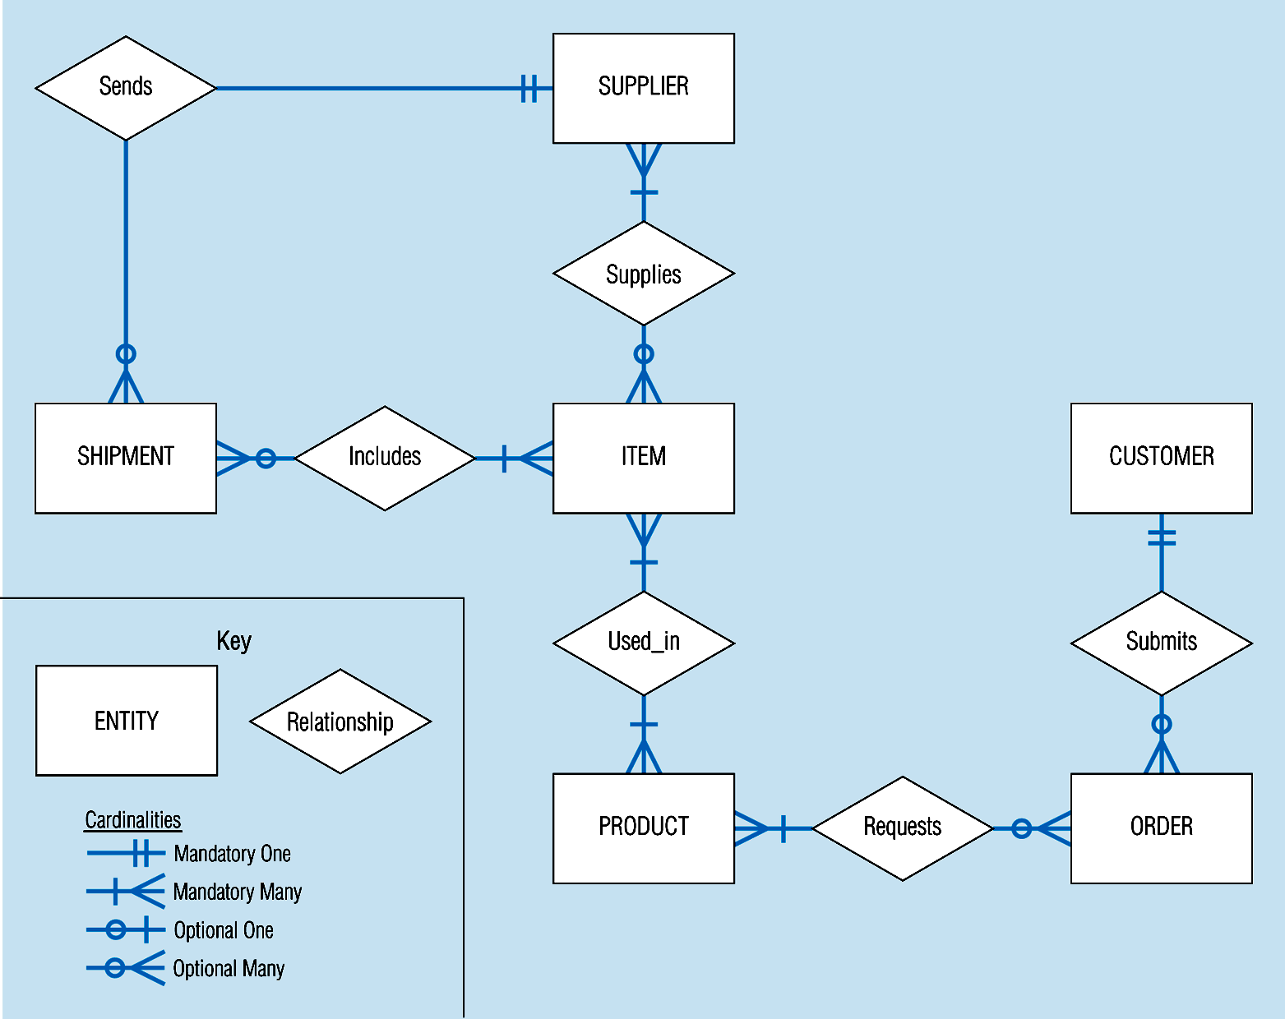
Supplier_ID
Supplier_Name
Supplier_Address
Figure: Sample E-R Diagram

Slide 17
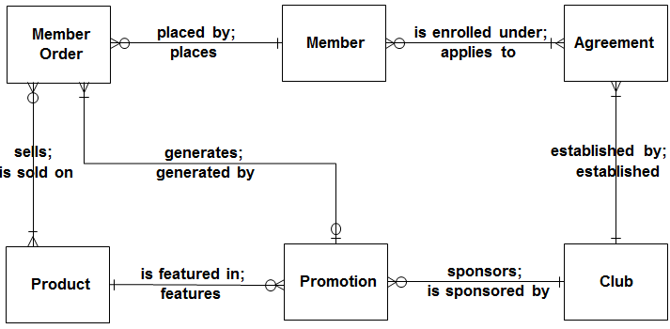
Figure: Sample E-R Diagram

Slide 18
A data warehouse is based on a multidimensional data model which views data in the form of a data cube
A data cube, such as sales, allows data to be modeled and viewed in multiple dimensions
Dimension tables, such as item (item_name, brand, type), or time(day, week, month, quarter, year)
Fact table contains measures (such as dollars_sold) and keys to each of the related dimension tables
The lattice of cuboids forms a data cube.

Slide 19
Cube: A Lattice of Cuboids
all
0-D(apex) cuboid
time
item
location
supplier
1-D cuboids
time,item
time,location
item,location
location,supplier
2-D cuboids
time,supplier
item,supplier
time,item,location
time,location,supplier
3-D cuboids
time,item,supplier
item,location,supplier
4-D(base) cuboid
time, item, location, supplier

Slide 20
Dimensions and Measures
The database component of a data warehouse is described using a technique called dimensionality modelling.
Every dimensional model (DM) is composed of one table with a composite primary key, called the fact table, and a set of smaller tables called dimension tables.
Each dimension table has a simple (non-composite) primary key that corresponds exactly to one of the components of the composite key in the fact table.

Slide 21
Fact Tables
A fact table is composed of two or more primary keys and usually also contains numeric data. Because it always contains at least two primary keys it is always a M-M relationship.
Fact tables contain business event details for summarization.
Because dimension tables contain records that describe facts, the fact table can be reduced to columns for dimension foreign keys and numeric fact values. Text and de-normalized data are typically not stored in the fact table.

Slide 22
The logical model for a fact table contains a foreign key column for the primary keys of each dimension.
The combination of these foreign keys defines the primary key for the fact table.
Fact tables are often very large, containing hundreds of millions of rows and consuming hundreds of gigabytes or multiple terabytes of storage.

Slide 23
Dimension Tables
Dimension tables encapsulate the attributes associated with facts and separate these attributes into logically distinct groupings, such as time, geography, products, customers, and so forth.
A dimension table may be used in multiple places if the data warehouse contains multiple fact tables or contributes data to data marts.
The data in a dimension is usually hierarchical in nature.
Hierarchies are determined by the business need to group and summarize data into usable information.
For example, a time dimension often contains the hierarchy elements: (all time), Year, Quarter, Month, Day, or (all time), Year Quarter, Week, Day.

Slide 24
Figure: Dimensional Model
Product
Key
Name
Description
Size
Price
Sale
Product Key
Market Key
Promotion Key
Time Key
Dollars
Units
Price
Cost
Market Region
Key
Description
District
Region
Demographics
Time
Key
Weekday
Holiday
Fiscal
Promotion
Key
Description
Discount
Media
Region
Product
Time

Slide 25
A Data Mining Query Language, DMQL: Language Primitives
Cube Definition (Fact Table)
define cube <cube_name> [<dimension_list>]: <measure_list>
Dimension Definition ( Dimension Table )
define dimension <dimension_name> as (<attribute_or_subdimension_list>)
Special Case (Shared Dimension Tables)
First time as “cube definition”
define dimension <dimension_name> as <dimension_name_first_time> in cube <cube_name_first_time>

Slide 26
Data Warehouse Schema
A data warehouse, however, requires a concise, subject-oriented schema that facilitates on-line data processing (OLAP).
The most popular data model for a data warehouse is a multidimensional model.
Such a model can exist in the following forms
a star schema
a snowflake schema
a fact constellation schema.
The major focus will be on the star schema which is commonly used in the design of many data warehouse.

Slide 27
Star Schema
The star schema is a data modeling technique used to map multidimensional decision support into a relational database.
Star schemas yield an easily implemented model for multidimensional data analysis while still preserving the relational structure of the operational database.
Others name: star-join schema, data cube, data list, grid file and multi-dimension schema

Slide 28
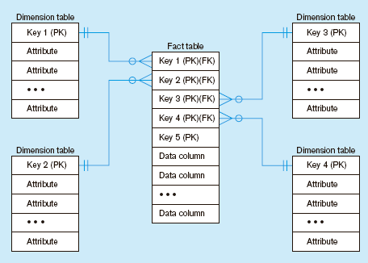
Excellent for ad-hoc queries, but bad for online transaction processing
Fact tables contain factual or quantitative data
1:N relationship between dimension tables and fact tables
Dimension tables are denormalized to maximize performance
Dimension tables contain descriptions about the subjects of the business
Figure: Components of a star schema

Slide 29
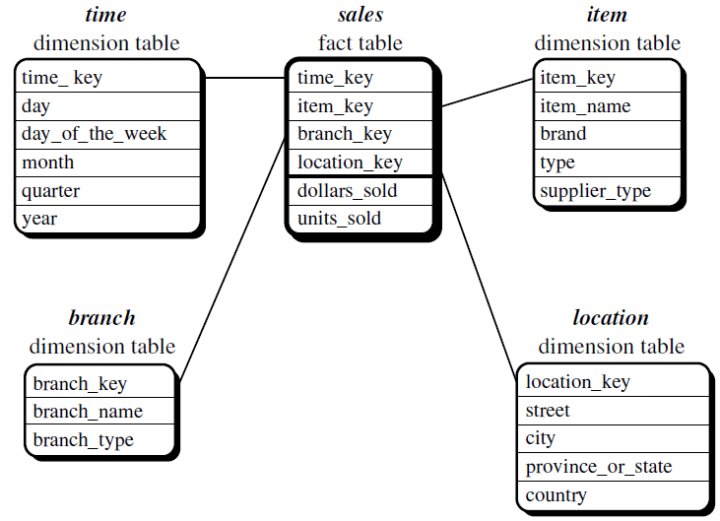
Figure: Star schema of a data warehouse for sales

Slide 30
The schema contains a central fact table for sales that contains keys to each of the four dimensions, along with two measures: dollars_sold, avg_sales, and units_sold.
To minimize the size of the fact table, dimension identifiers (such as time key and item key) are system-generated identifiers.
Notice that in the star schema, each dimension is represented by only one table, and each table contains a set of attributes.
For example, the location dimension table contains the attribute set {location key, street, city, province or state, country}

Slide 31
Defining a Star Schema in DMQL
define cube sales_star [time, item, branch, location]:
dollars_sold = sum(sales_in_dollars), avg_sales = avg(sales_in_dollars), units_sold = count(*)
define dimension time as (time_key, day, day_of_week, month, quarter, year)
define dimension item as (item_key, item_name, brand, type, supplier_type)
define dimension branch as (branch_key, branch_name, branch_type)
define dimension location as (location_key, street, city, province_or_state, country)

Slide 32
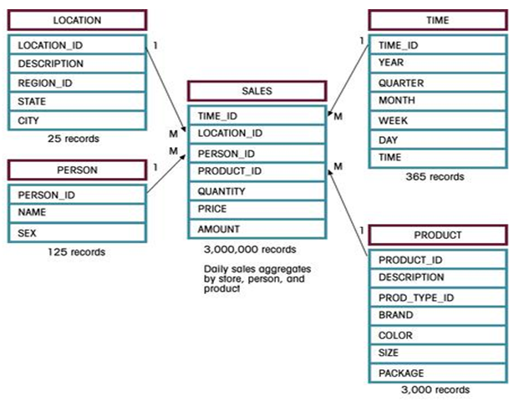
Figure: Star Schema for Sales

Slide 33
Advantages of Star Schema
Star Schema is very easy to understand, even for non technical business manager.
Star Schema provides better performance and smaller query times
Star Schema is easily extensible and will handle future changes easily

Slide 34
Issues Regarding Star Schema
Dimension table keys must be surrogate (non-intelligent and non-business related), because:
Keys may change over time
Length/format consistency
Granularity of Fact Table–what level of detail do you want?
Transactional grain–finest level
Aggregated grain–more summarized
Finer grains ➔ better market basket analysis capability
Finer grain ➔ more dimension tables, more rows in fact table
Duration of the database–how much history should be kept?
Natural duration–13 months or 5 quarters
Financial institutions may need longer duration
Older data is more difficult to source and cleanse

Slide 35
Snowflake Schema
A schema is called a snowflake schema if one or more dimension tables do not join directly to the fact table but must join through other dimension tables.
It is a variant of star schema model. It has a single, large and central fact table and one or more tables for each dimension.
Characteristics:
Normalization of dimension tables
Each hierarchical level has its own table
less memory space is required
a lot of joins can be required if they involve attributes in secondary dimension tables

Slide 36
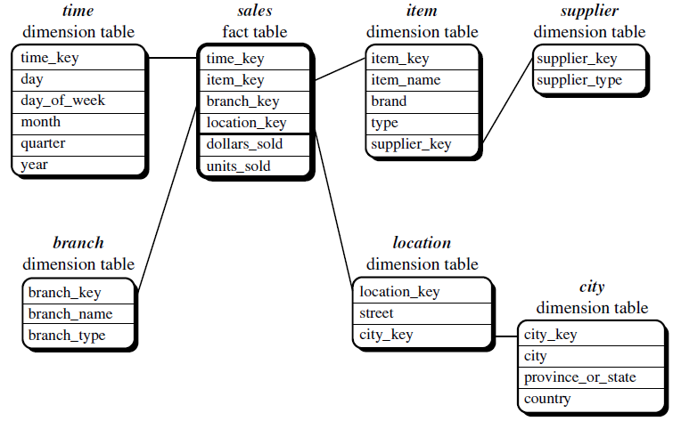
Figure: Snowflake schema of a data warehouse for sales

Slide 37
Defining a Snowflake Schema in DMQL
define cube sales_snowflake [time, item, branch, location]:
dollars_sold = sum(sales_in_dollars), avg_sales = avg(sales_in_dollars), units_sold = count(*)
define dimension time as (time_key, day, day_of_week, month, quarter, year)
define dimension item as (item_key, item_name, brand, type, supplier(supplier_key, supplier_type))
define dimension branch as (branch_key, branch_name, branch_type)
define dimension location as (location_key, street, city(city_key, province_or_state, country))

Slide 38
Order
Product
Order No
Order Date
Category
ProductNO
ProdName
ProdDescr
Category
Category
UnitPrice
CategoryName
CategoryDescr
Fact Table
Customer
OrderNO
SalespersonID
CustomerNO
ProdNo
DateKey
CityName
Quantity
Total Price
Customer No
Customer Name
Customer Address
City
Date
Month
DateKey
Date
Month
Year
Month
Year
Year
Salesperson
City
SalespersonID
SalespersonName
City
Quota
State
CityName
State
Country
StateName
Country

Slide 39
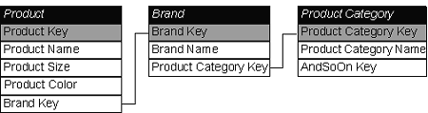
Figure: Snowflake Schema

Slide 40
Figure: Snowflake Schema
Store Dimension
Fact Table
Time Dimension
Store Key
Product Key
Period Key
Units
Price
Period Key
Year
Quarter
Month
Store Key
Store Name
City Key
City Key
City
State
Region
Product Key
Product Desc
Product Dimension
City Dimension

Slide 41
Difference between Star Schema and Snow-flake Schema
Star Schema is a multi-dimension model where each of its disjoint dimension is represented in single table.
Snow-flake is normalized multi-dimension schema when each of disjoint dimension is represent in multiple tables.
Star schema can become a snow-flake
Both star and snowflake schemas are dimensional models; the difference is in their physical implementations.
Snowflake schemas support ease of dimension maintenance because they are more normalized.
Star schemas are easier for direct user access and often support simpler and more efficient queries.
It may be better to create a star version of the snowflaked dimension for presentation to the users

Slide 42
Fact-Constellation Schema
Multiple fact tables share dimension tables.
This schema is viewed as collection of stars hence called as galaxy schema or fact constellation.
Sophisticated application requires such schema.
In the Fact Constellations, aggregate tables are created separately from the detail, therefore, it is impossible to pick up, for example, Store detail when querying the District Fact Table.
Fact Constellation is a good alternative to the Star, but when dimensions have very high cardinality, the sub-selects in the dimension tables can be a source of delay.

Slide 43
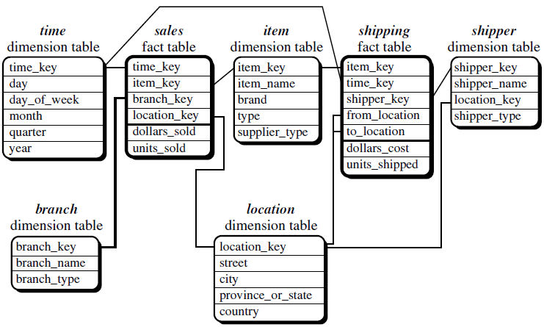
Figure: Fact constellation schema of a data warehouse for sales and shipping

Slide 44
Defining a Fact Constellation in DMQL
define cube sales [time, item, branch, location]:
dollars_sold = sum(sales_in_dollars), avg_sales = avg(sales_in_dollars), units_sold = count(*)
define dimension time as (time_key, day, day_of_week, month, quarter, year)
define dimension item as (item_key, item_name, brand, type, supplier_type)
define dimension branch as (branch_key, branch_name, branch_type)
define dimension location as (location_key, street, city, province_or_state, country)
define cube shipping [time, item, shipper, from_location, to_location]:
dollar_cost = sum(cost_in_dollars), unit_shipped = count(*)
define dimension time as time in cube sales
define dimension item as item in cube sales
define dimension shipper as (shipper_key, shipper_name, location as location in cube sales, shipper_type)
define dimension from_location as location in cube sales
define dimension to_location as location in cube sales

Slide 45
More Examples on Fact-Constellation Schema
Sales
Fact Table
Shipping
Fact Table
Store Key
Product Key
Period Key
Units
Price
Product Dimension
Shipper Key
Store Key
Product Key
Period Key
Units
Price
Product Key
Product Desc
Store Dimension
Store Key
Store Name
City
State
Region

Slide 46
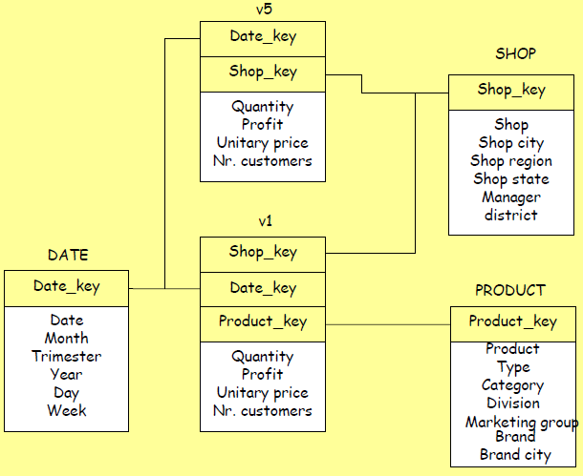

Slide 47
District Fact Table
Region Fact Table
District_ID
PRODUCT_KEY
PERIOD_KEY
Region_ID
PRODUCT_KEY
PERIOD_KEY
Dollars
Units
Price
Dollars
Units
Price

Slide 48
Multidimensional Data Model
Data warehouses and OLAP tools are based on a multidimensional data model. This model views data in the form of a data cube.
“What is a data cube?” A data cube allows data to be modeled and viewed in multiple dimensions. It is defined by dimensions and facts.
In general terms, dimensions are the perspectives or entities with respect to which an organization wants to keep records.
Each dimension may have a table associated with it, called a dimension table, which further describes the dimension.
A multidimensional data model is typically organized around a central theme, like sales, for instance. This theme is represented by a fact table. Facts are numerical measures.

Slide 49
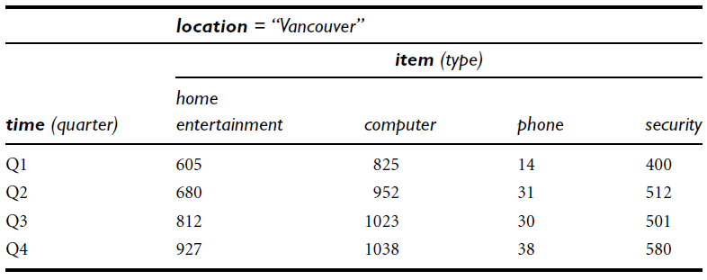
Table: A 2-D view of sales data according to the dimensions time and item, where the sales are from branches located in the city of Vancouver. The measure displayed is dollars sold (in thousands).

Slide 50
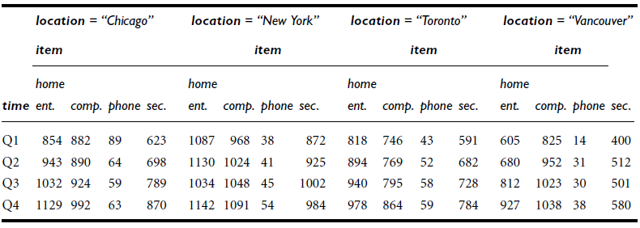
Table: A 3-D view of sales data according to the dimensions time, item, and location. The measure displayed is dollars sold (in thousands).

Slide 51
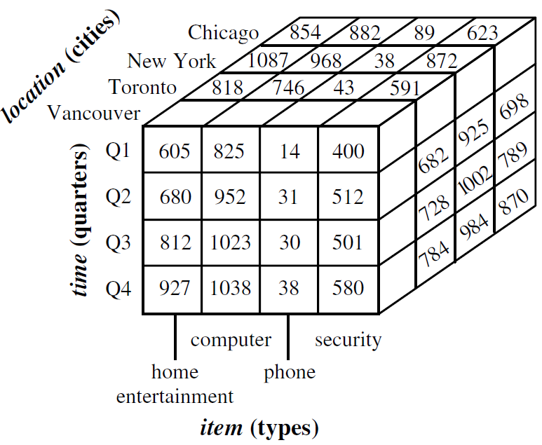
Figure: A 3-D data cube representation of the data in the table above, according to the dimensions time, item, and location. The measure displayed is dollars sold (in thousands).

Slide 52
Question?
Suppose that we would now like to view our sales data with an additional fourth dimension, such as supplier.
What should we do??
Any Solution???

Slide 53
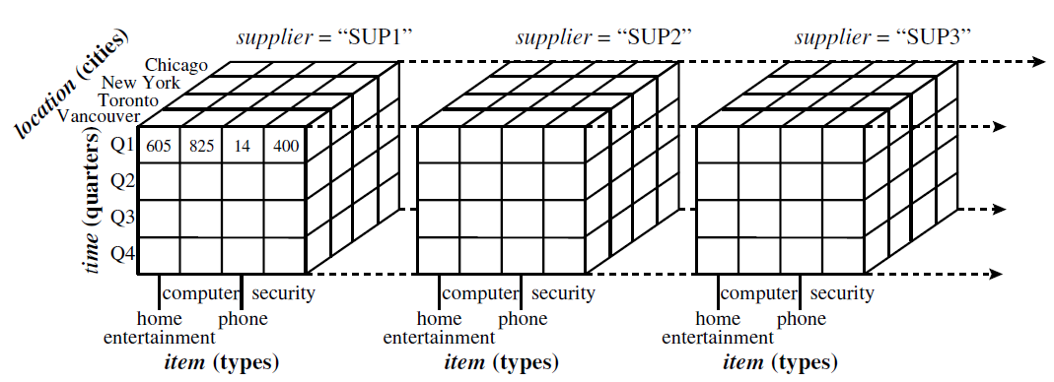
Solution!!
Viewing things in 4-D becomes tricky. However, we can think of a 4-D cube as being a series of 3-D cubes as shown below:
Figure: A 4-D data cube representation of sales data, according to the dimensions time, item, location, and supplier. The measure displayed is dollars sold (in thousands). For improved readability, only some of the cube values are shown.

Slide 54
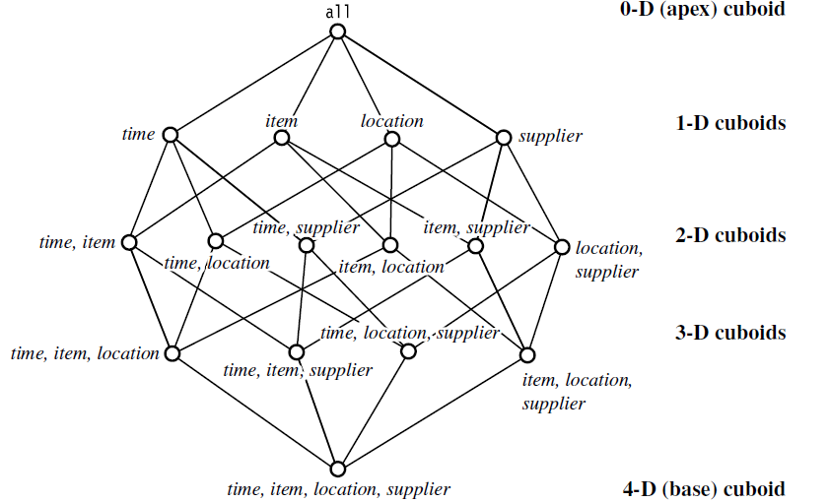
Figure: Lattice of cuboids, making up a 4-D data cube for the dimensions time, item, location, and supplier. Each cuboid represents a different degree of summarization.

Slide 55
Measures: Their Categorization and Computation
“How are measures computed?”
A data cube measure is a numerical function that can be evaluated at each point in the data cube space.
A measure value is computed for a given point by aggregating the data corresponding to the respective dimension-value pairs defining the given point.
Measures can be organized into three categories (i.e., distributive, algebraic, holistic), based on the kind of aggregate functions used.

Slide 56
Distributive Measure
A measure is distributive if it is obtained by applying a distributive aggregate function.
An aggregate function is distributive if it can be computed in a distributed manner.
Example: count(), sum(), min(), max().

Slide 57
Algebraic Measure
A measure is algebraic if it is obtained by applying an algebraic aggregate function.
An aggregate function is algebraic if it can be computed by an algebraic function.
Example: avg(), min_N(), standard_deviation().

Slide 58
Holistic Measure
A measure is holistic if it is obtained by applying a holistic aggregate function.
An aggregate function is holistic if there is no constant bound on the storage size needed to describe a sub-aggregate.
Example: median(), mode(), rank().

Slide 59
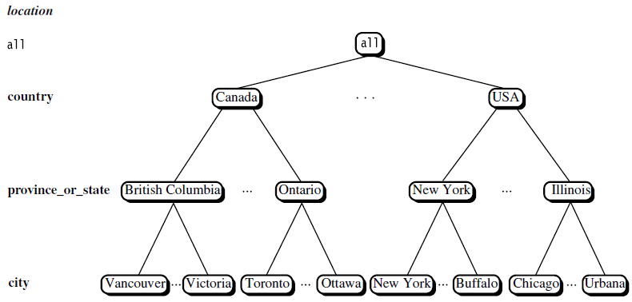
Concept Hierarchies
A concept hierarchy defines a sequence of mappings from a set of low-level concepts to higher-level, more general concepts.
Figure: A concept hierarchy for the dimension location.

Slide 60
In the above figure we have considered a concept hierarchy for the dimension location. City values for location include Vancouver, Toronto, New York, and Chicago. Each city, however, can be mapped to the province or state to which it belongs.
For example, Vancouver can be mapped to British Columbia, and Chicago to Illinois. The provinces and states can in turn be mapped to the country to which they belong, such as Canada or the USA.
These mappings form a concept hierarchy for the dimension location, mapping a set of low-level concepts (i.e., cities) to higher-level, more general concepts (i.e., countries).

Slide 61
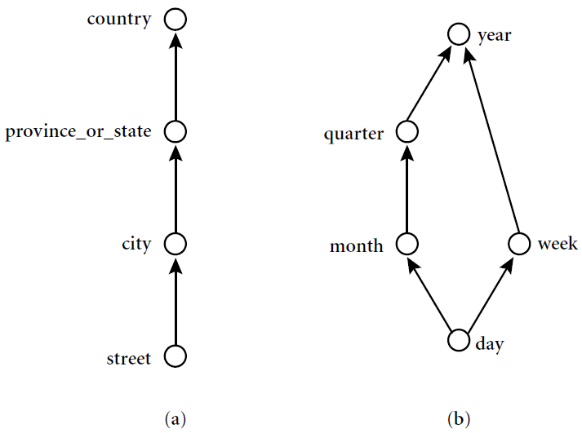
Figure: Hierarchical and lattice structures of attributes in warehouse dimensions: (a) a hierarchy for location; (b) a lattice for time.

Slide 62
Many concept hierarchies are implicit within the database schema. For example, suppose that the dimension location is described by the attributes number, street, city, province or state, zip code, and country.
These attributes are related by a total order, forming a concept hierarchy such as “street < city < province or state < country”. This hierarchy is shown in the figure (a) above.

Slide 63
Alternatively, the attributes of a dimension may be organized in a partial order, forming a lattice.
An example of a partial order for the time dimension based on the attributes day, week, month, quarter, and year is “day < {month <quarter; week} < year”.
This lattice structure is shown in the figure (b) as above.

Slide 64
Materialized View
Materialized views are query results that have been stored in advance so long-running calculations are not necessary when you actually execute your SQL statements.
Materialized views can be best explained by Multidimensional lattice.

Slide 65
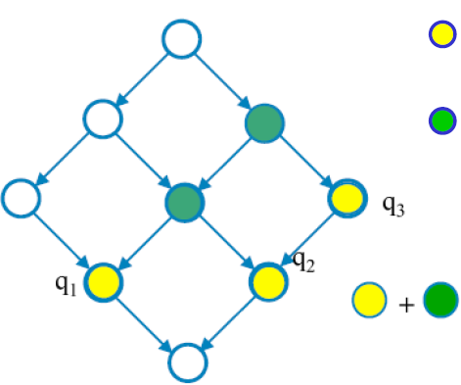
= exact views: They solve exactly the queries
= less aggregate views: They solve more than one query
= candidate views: They could reduce elaboration costs

Slide 66
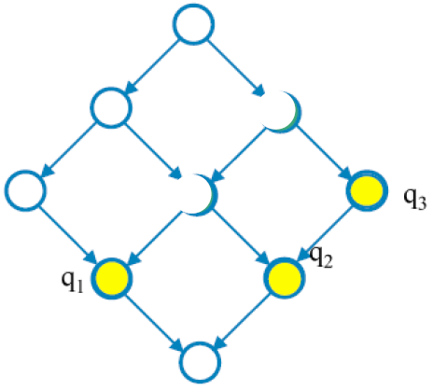
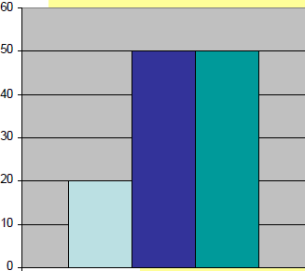
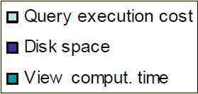

Slide 67
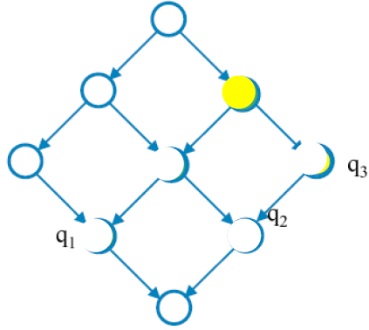
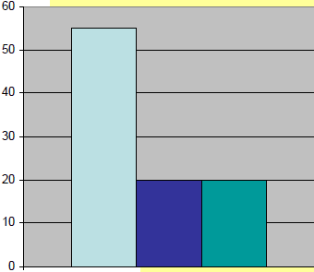

Slide 68
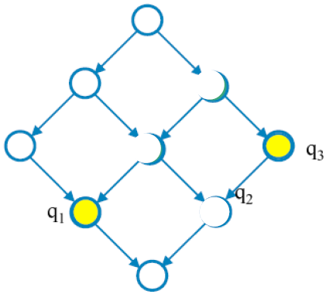
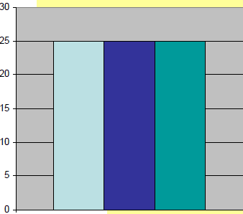

Slide 69
It is useful to materialize a view when:
It directly solves a frequent query
It reduce the costs of some queries
It is not useful to materialize a view when:
Its aggregation pattern is the same as another materialized view
Its materialization does not reduce the cost

Slide 70
Class Assignment (1)
Suppose that a data warehouse consists of the three dimensions time, doctor, and patient, and the two measures count and charge, where charge is the fee that a doctor charges a patient for a visit.
Enumerate three classes of schemas that are popularly used for modeling data warehouses.
(b) Draw a schema diagram for the above data warehouse using one of the schema classes listed in (a).

Slide 71
Class Assignment (2)
Suppose that a data warehouse for XYZ University consists of the following four dimensions: student, course, semester, and instructor, and two measures count and avg grade.
When at the lowest conceptual level (e.g., for a given student, course, semester, and instructor combination), the avg grade measure stores the actual course grade of the student. At higher conceptual levels, avg grade stores the average grade for the given combination.
(a) Draw a snowflake schema diagram for the data warehouse.

Slide 72
Class Assignment (3)
A data warehouse can be modeled by either a star schema or a snowflake schema. Briefly describe the similarities and the differences of the two models, and then analyze their advantages and disadvantages with regard to one another.
Give your opinion of which might be more empirically useful and state the reasons behind your answer.

Slide 73
Class Assignment (4)
Let us consider the case of a real estate agency whose database is composed by the following tables:
OWNER (IDOwner, Name, Surname, Address, City, Phone)
ESTATE (IDEstate, IDOwner, Category, Area, City, Province, Rooms, Bedrooms, Garage, Meters)
CUSTOMER (IDCust, Name, Surname, Budget, Address, City, Phone)
AGENT (IDAgent, Name, Surname, Office, Address, City, Phone)
AGENDA (IDAgent, Data, Hour, IDEstate, ClientName)
VISIT (IDEstate, IDAgent, IDCust, Date, Duration)
SALE (IDEstate, IDAgent, IDCust, Date, AgreedPrice, Status)
RENT (IDEstate, IDAgent, IDCust, Date, Price, Status, Time)
Design a Star Schema or Snowflake Schema for the DW.

Slide 74
Hints:
The following ideas will be used during the solution of the exercise:
supervisors should be able to control the sales of the agency
FACT Sales
MEASURES OfferPrice, AgreedPrice, Status
DIMENSIONS EstateID, OwnerID, CustomerID, AgentID,
TimeID
supervisors should be able to control the work of the agents by analyzing the visits to the estates, which the agents are in charge of
FACT Viewing
MEASURES Duration
DIMENSIONS EstateID, CustomerID, AgentID, TimeID

Slide 75
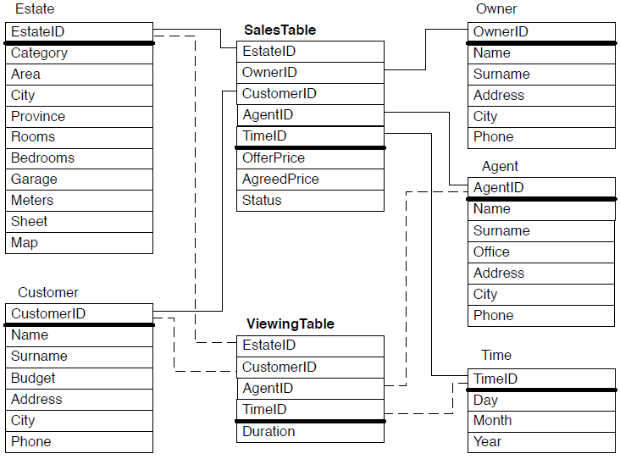
Solution for Class Assignment (4)
Figure: Star schema

Slide 76
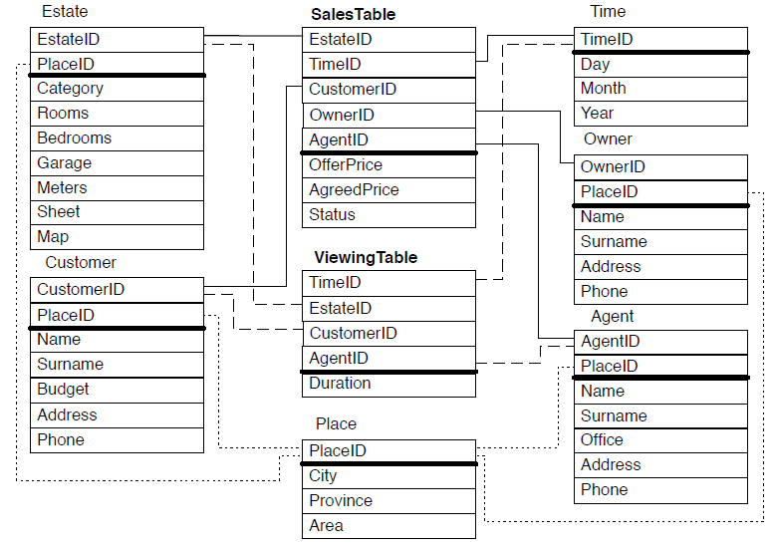
Figure: Snowflake schema

Slide 77
Class Assignment (5)
An online order wine company requires the designing of a data warehouse to record the quantity and sales of its wines to its customers. Part of the original database is composed by the following tables:
CUSTOMER (Code, Name, Address, Phone, BDay, Gender)
WINE (Code, Name, Type, Vintage, BottlePrice, CasePrice, Class)
CLASS (Code, Name, Region)
TIME (TimeStamp, Date, Year)
ORDER (Customer, Wine, Time, nrBottles, nrCases)
Note that the tables represent the main entities of the ER schema, thus it is necessary to derive the significant relationships among them in order to correctly design the data warehouse.
Construct Snowflake Schema.

Slide 78
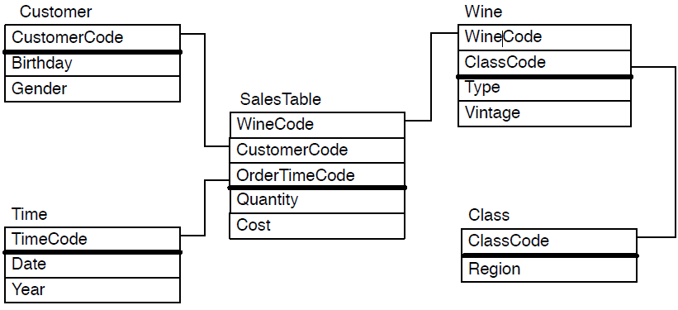
Solution for Class Assignment (5)
Figure: Snowflake schema
FACT Sales
MEASURES Quantity, Cost
DIMENSIONS Customer, Area, Time, Wine Class

Slide 79
Questions?

Slide 80
References
Sam Anahory, Dennis Murray, “Data warehousing In the Real World”, Pearson Education.
Kimball, R. “The Data Warehouse Toolkit”, Wiley, 1996.
Teorey, T. J., “Database Modeling and Design: The Entity-Relationship Approach”, Morgan Kaufmann Publishers, Inc., 1990.
“An Overview of Data Warehousing and OLAP Technology”, S. Chaudhuri, Microsoft Research
“Data Warehousing with Oracle”, M. A. Shahzad

Slide 81
End of Unit 2

Slide 82
Thank you !!!

